Slide 1
In this ppt file
Kerberos
Passwords and password management

Slide 2

Kerberos
A practical authentication service
Kerberos: three headed dog in Greek mythology, the guardian of the entrance of Hades
Those three heads in security: AAA (Authentication, Accounting, Audit)
However in Kerberos the last two heads never implemented

Slide 3
Authentication as a Service
we have seen several authentication protocols
now we will see a system where we can use such a protocol in practice

Slide 4
Kerberos
an “authentication service” based on private-key crypto
developed at MIT
alternative to implementing an authentication protocol with each application server
  instead a centralized authentication server manages authentication between users and application servers/workstations
provides centralized third-party authentication in a distributed network
  allows users access to services through distributed network without needing to trust all workstations
  rather everybody trusts a central authentication server
two versions in use: 4 and 5

Slide 5
Kerberos Requirements
security
  opponents should not be able to gain access
reliability (availability)
  a Kerberos server or its substitute should be available all the time
scalability
  system should be able to support large amount of users
reliability and scalability imply a distributed architecture
transparency
  users should see the system as a username/password system

Slide 6
Kerberos Protocols
implemented using an authentication protocol based on Needham-Schroeder
  not exactly the same
we will explain them by starting some simple protocols

Slide 7
A Simple Authentication Dialogue
Authentication Server (AS)
  knows the passwords of all clients
  shares secret key with each server (K_{server})
  also provides access control by checking if a client is authorized to access a particular server
Client → AS: ID_{client} || Pass_{Client} || ID_{Server}
AS → Client: Ticket
Client → Server: ID_{client} || Ticket
Ticket = E (K_{server}, [ID_{client} || Addr_{client} || ID_{server}])
Questions
  why ID_{client} is sent also unencrypted in 3?
  why do we need Addr_{client} in ticket?
Notes:
ID_client is needed to check if the ticket submitter is the client or not. It is analogous to ordinary tickets that bear a name on it. The server should check your identity before accepting that ticket.
Client’s network address is included in the ticket in order to prevent an attacker to capture the ticket and to submit as if it is the legit client.

Slide 8
A Simple Authentication Dialogue
Remaining problems
  password is sent in clear
  ticket replay prevention
  proof of authentication (ID and address check) is not so strong
  ticket reuse
    very important for a practical system
Why ticket reuse is necessary?
  avoid entering password several times (say in a day)
    would you like to enter your password everytime IMAP client checks your inbox?
    would you like to enter the same password for each service (like print service, file server, …)?

Slide 9
Improved Authentication Dialogue
a new server called Ticket Granting Server (TGS) is employed
  AS is still there, but does not issue tickets for servers. AS issues tickets for TGS
    ticket-granting ticket
  TGS issues tickets for servers
    service-granting ticket
Password transfer is avoided by encrypting AS messages to clients using a key derived from password
still not complete

Slide 10
Improved Authentication Dialogue - 1
messages 1 and 2 are per logon session
  Client → AS: ID_{Client} || ID_{TGS}
  AS → Client: E (K_{client}, [Ticket_{TGS}])
Ticket_{TGS} = E (K_{TGS}, [ID_{Client} || Addr_{Client} || ID_{TGS} || Timestamp₁ || Lifetime₁])

Slide 11
Improved Authentication Dialogue - 2
messages 3 and 4 are per server
  Client → TGS: ID_{Client} || ID_{Server} || Ticket_{TGS}
  TGS → Client: Ticket_{Server}
message 5 is per service session
  Client → Server: ID_{Client} || Ticket_{Server}
Ticket_{Server} = E (K_{server}, [ID_{Client} || Addr_{Client} || ID_{Server} || Timestamp₂ || Lifetime₂])

Slide 12
Improved Authentication Dialogue
Encryption of Ticket_{TGS} with K_{Client} provides authentication of client
  how?
Encryption of ticket contents with TGS’s or server’s key provides integrity
Timestamps and Lifetimes in tickets make them reusable for a period of time
  this period is a tradeoff and generally not so large
still uses network addresses for authentication
  not so good, because if network address is spoofed within the lifetime of a ticket, then impersonation/replay is possible
Notes:
How? K_Client is derived from client's password. If the client does not know correct password, he cannot decrypt.

Slide 13
Kerberos Version 4
solves the problem of “ticket replay” and “impersonation” by an attacker
  TGS or server must make sure that the ticket user is the user to whom ticket was issued
  a new concept is added: authenticators
    in addition to tickets
    uses session key concept
provides mutual authentication
  application servers authenticate themselves to clients as well

Slide 14
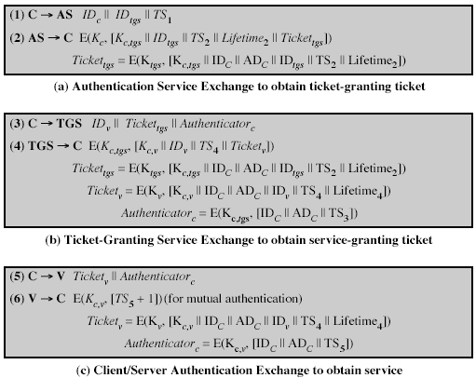
I think Lifetime₄ should also be here (in addition to Ticket_{v})

Slide 15
Kerberos Version 4
Key issues
  authenticator has a very small lifetime (5 ms), so that its replay is not so possible (or at least very hard)
  authenticators are generated by session keys and session keys are known by the client, the server, AS and TGS
    that provides authentication
Session keys can be used to encrypt future communications
Question
  why do we have ID and address fields in authenticators?
Notes:
Kaufman, Perlman, Speciner, pp 326

Slide 16
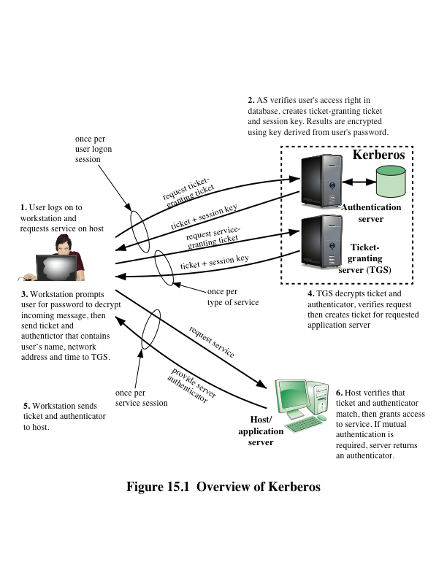
Kerberos 4 Overview

Slide 17
Kerberos 4 Overview
a TTP based authentication scheme that uses symmetric crypto
has an Authentication Server (AS)
  users initially negotiate with AS to identify themselves
  AS provides an authentication credential (ticket granting ticket - TGT)
has a Ticket Granting Server (TGS)
  users subsequently request access to other services from TGS using TGT and authenticator
AS and TGSs are trusted by all clients and servers

Slide 18
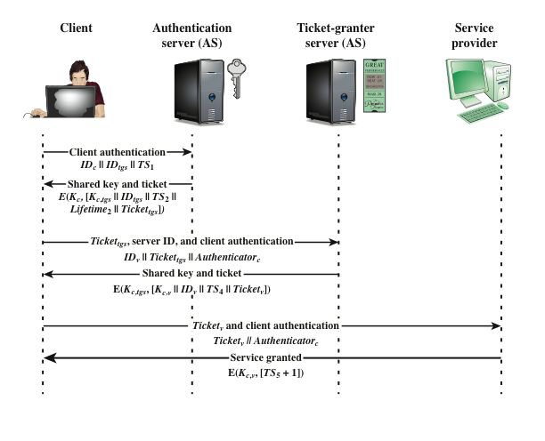
Kerberos 4 Overview

Slide 19
Kerberos Realms
a Kerberos environment consists of:
  a Kerberos server (AS + TGS)
  a number of clients, all registered with Kerberos server
  application servers, sharing keys with Kerberos server
this is termed a realm
  typically a single administrative domain
if there are multiple realms, their Kerberos servers must share keys and trust each other
  N realms means N.(N-1)/2 secure interrealm keys

Slide 20
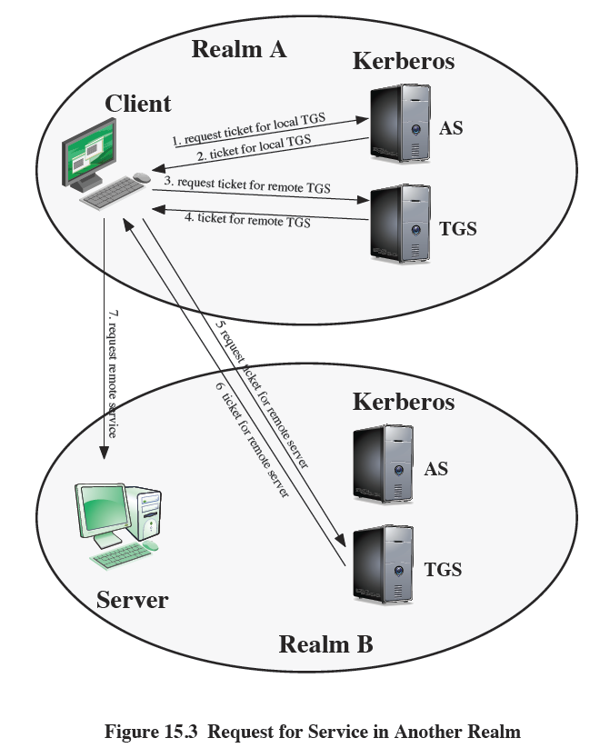
Inter-realm authentication

Slide 21
Kerberos Version 5
developed in mid 1990’s
specified by IETF as RFC 4120
provides improvements over v4
  efforts to make Kerberos general-purpose
    encryption algorithm: v4 was only DES, v5 provides flexibility
    network protocol addresses: v4 was only IP addresses, v5 provides flexibility
    ticket lifetime: v4 was max. 1280 minutes due to length of the lifetime field, v5 supports arbitrary lifetime
    authentication forwarding: In practice a server may access another server on behalf of a client during a transaction. v4 does not, but v5 allows this.

Slide 22
Kerberos Version 5
Kerberos v5 solves some technical deficiencies
  double encryption
    in v4, tickets were unnecessarily doubly encrypted. In v5, this is removed.
  v4 was using a non-standard DES mode which is shown to be vulnerable. v5 uses standard CBC mode
  replays
    are not 100% avoided in v4.
    AS → Client and TGS → Client messages could be replayed during a lifetime of a ticket. In v5 nonces are used
    since sessions keys are the same for multiple client-server connections using the same ticket, encrypted packets from old connections may have been replayed.
    v5 uses subkey mechanisms to avoid this type of replays.

Slide 23
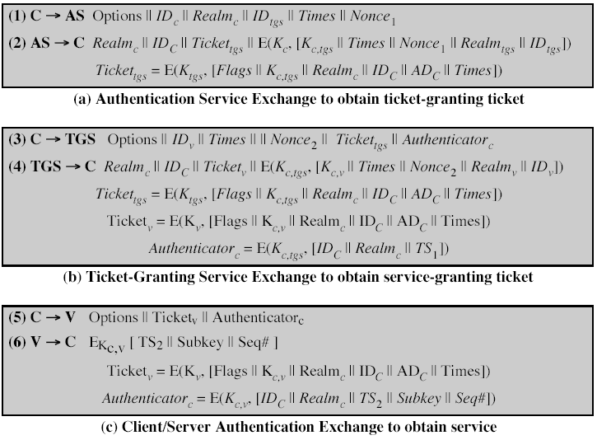
|| Realm_{v}
Notes:
Normally in message 1 client and TGS are in the same realm, so one realm in msg 1 is OK. (ref. Kaufman pp.358)

Slide 24
Differences in messages btw v4 & v5
General
  client realm together with ID_client
  server realm together with ID_server
Message 1
  options (client’s request of ticket functionality (flags)), times (client’s request of ticket validity), nonce (for replay control)
Message 2
  ticket is encrypted only once
  ticket includes flags (current ticket status and other functionality)
  nonce is returned to prove freshness
  Client ID and Realm are added to inform the client about the key to be used to decrypt the message

Slide 25
Differences in messages btw v4 and v5
Message 3
  requested times and options are sent to TGS by Client
  authenticator is essentially same as v4
  nonce
Message 4
  ticket for server has a similar structure as the ticket for TGS
  nonce is returned for replay check

Slide 26
Differences in messages btw v4 and v5
Message 5
  authenticator for server is quite different in v5
    subkey: client’s choice for an encryption key for the session. To avoid replays from previous sessions
    sequence number: optional accompanying mechanism for replays. Indicates the starting value for client-to-server messages
Message 6
  server may enforce its own subkey
  (optional) initial sequence number for server-to-client messages

Slide 27
Some Ticket Flags (Options) – Full list is at pp. 498-500 of Stallings
Renewable
  long lived tickets are risky (may be stolen and the opponent can use until the expiration time)
  short lived ones cause protocol overheads
    for TGT, the user should enter password for each ticket
  Solution: ticket originally has short lifetime, but can be periodically (and automatically) renewed
    until renew-till time specified in the ticket
    unless TGS or AS refuses to renew it (if stolen)

Slide 28
Ticket Flags (some of them)
Proxiable / Proxy
  If a TGT is proxiable, then TGS may issue proxy tickets that the ticket owner (say Alice) may give some other servers that may act on behalf of Alice
Forwardable / Forwarded
  more powerful than proxy
    proxy flag can be set only in server tickets
    forwarded flag can be set also in TGTs
  if a TGT bears a forwardable flag set, than TGS may issue forwarded TGTs for a nearby realm
    nearby realm’s TGS may either forward or issue a server ticket.
    In this way, realms can be connected

Slide 29
Passwords and Password Management
A sequence of symbols that only you know and the system that authenticates you can verify
Not only about Kerberos, but also for all practical systems
  inevitable mechanism for authentication
Password related threats
  Guessing
  Spoofing
  Cracking the password file
Password related rules
  How to choose
  How to manage

Slide 30
Password Guessing
Exhaustive Search (Brute Force)
  try all possible combinations
  may work if the symbol space and password length are small
Intelligent Search
  search possible passwords in a restricted space
    related to the user: girlfriend/boyfriend name, car brand, phone number, birth date, …
    generic: meaningful words or phrases, dictionary attack

Slide 31
Password Selection Guidelines
“Have” a password and don’t share it
  do not leave it blank
Do not use default passwords, change them ASAP
  like “pass”
Use mixed symbols
  upper and lowercase letters, digits, symbols
use long passwords
avoid meaningful and obvious words and their derivatives
  e.g. RoseGarden1, Albert_Levi123
A useful mechanism: Pick a phrase or sentence and use initials as password
  e.g. “I hate when system asks me to change password” → Ihwsam2cp

Slide 32

How the system helps?
Sysadmin can try to guess a password with known techniques
Password ageing
  users are enforced to change their passwords periodically
  possibly by prohibiting to use old passwords
Limit login attempts
  temporarily blocks the account after some login failures
Use of CAPTCHA
  To mitigate automated online guessing attempts
Inform user
  about last successful login time and number of unsuccessful attempts

Slide 33
Average user behavior
They do not memorize long and random password
  instead they prefer to write down passwords
they tend to derive passwords from the old one
  e.g. by adding 1, 2, …
  guessing one makes easier to guess the forthcoming ones
They prefer not to change or revert back to their original password
  so it is not a good idea to enforce them to change passwords too often

Slide 34
Rule of thumb
  “Enforcing too much security may weaken the system, since the users tend to circumvent security rules to do their job properly”

Slide 35
Password Spoofing
Are you really talking to the server that you want to talk?
  fake login prompts
    when you try to login a shared station
      previous user may leave a fake login screen
    how to avoid/detect
      reboot
remote login is even worse,
  telnet sends passwords in clear
  use SSH (Secure Shell)
Shoulder surfing
  Check surroundings in public spaces

Slide 36
Password Storage
Passwords should be able to be verified by the server
  so the passwords should be stored, but how?
Passwords are generally stored in encrypted form
  using symmetric encryption or one-way hash functions
Possible off-line attack
  Even if the passwords are stored in encrypted form, dictionary attacks are possible when the file contains the encrypted passwords is obtained by the attacker
  this is a passive off-line attack
    unsuccessful attempt limits do not help

Slide 37
How to prevent dictionary attacks on password files – 1
Slow down password encryption
  UNIX crypt function
    repeats a modified version of DES 25 times
    on all-zero block data and using the password as the key
Do not make the password file publicly readable
  shadow passwd file in UNIX systems

Slide 38
How to prevent dictionary attacks on password files - 2
Password Salting
  Encrypt passwords with additional random value (salt)
  salt is not a secret value
  store the encrypted password with salt
  Salting slows down dictionary attack
    since the attacker should run a brand new dictionary search for each user
  Another advantage
    if two users have the same password, their encrypted passwords will not be same (of course if the salt values are not accidentally the same)

Slide 39
Other Authentication Approaches
Password is example of “what you know” type of authentication
  it is a piece of information
  may be guessed or obtained by the attacker
Other authentication instruments also exist
  What you have (smartcards, tokens, …)
  Who you are (biometrics)
  What you do (dynamic handwritten signature, key strokes, gait)
  Where you are (on the network or physically using GPS)

Slide 40
Other Authentication Approaches
Who you are (Biometrics)
  uses unique biological properties like
    fingerprint
    palm print
    retina pattern
  does not have 100% accuracy
    false accept
      should reject, but accepts - very bad
    false reject
      should accept, but rejects
      not so bad but may create lots of false alarms and user-unfriendliness that make the system inefficient
    trade-off between false accept and false reject
  two controversies
    if copied or broken, you cannot change it
    people may not like their fingerprints are taken as criminals or beams in their eyes

Slide 41
Other Authentication Approaches
What you have
  a physical device that you hold
  Smartcards, smart tokens and smart phones are the best examples
    Mostly to generate or receive one-time passwords
  can be stolen or lost
    should be used together with a PIN or password
What you do
  mechanical tasks that have specific properties that only you can do
  dynamic signatures
    pressure, speed, orientation are properties as well as the shape
  Keyboard typing
    speed, intervals between keystrokes
  false accept, false reject problems exist here too

